Slide 1

Natural Language Processing
Rohit Kate
Introduction to Machine Learning
Part 3

Slide 2
Hidden Unit Representations
Trained hidden units can be seen as automatically learned higher-level features that help in learning the target concept
On many real domains, hidden units can be interpreted as representing meaningful features such as vowel detectors in speech recognition or edge detectors in image recognition, etc.
However, the hidden layer can also become a distributed representation of the input in which each individual unit is not easily interpretable as a meaningful feature

Slide 3
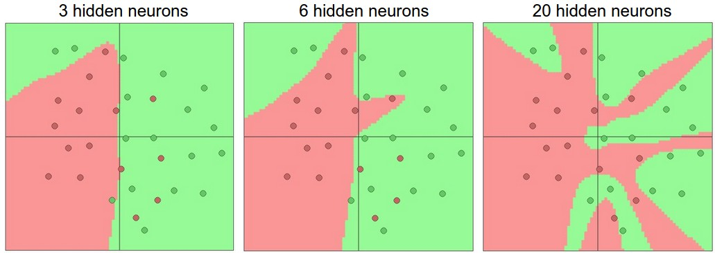
Number of Hidden Nodes
Larger neural networks can represent more complex functions
Image from: http://cs231n.github.io/neural-networks-1/

Slide 4
Determining the Best Number of Hidden Nodes
Too few hidden nodes prevents the network from adequately fitting the data
Too many hidden nodes can result in over-fitting
Use hold-out set (pseudo test set; part of the training data not used for training) to empirically determine an optimal number of hidden nodes for a dataset
error
on test data
on training data
0
# hidden nodes

Slide 5
Representational Power
Neural Network is essentially a function approximation technique
output = f(inputs)
Boolean functions: Any Boolean function can be represented by a two-layer network (output + hidden)
Continuous functions: Any bounded continuous function can be approximated to an arbitrarily small error by a two-layer network (output + hidden)
Any function: Any function can be approximated to an arbitrarily small error by a three-layer network (output + 2 hidden)

Slide 6
Representational Power
However:
You need sufficient number of hidden nodes
Sometimes impractically large
Training process may not actually find a good approximation function
The previous slide is only theoretically talking about the representation power
There is no guarantee that a training algorithm will actually find the approximation
Although theoretically it is not necessary to go beyond three layers, we will see in next classes that neural networks with several layers (i.e. deep) practically work better in many applications

Slide 7
Training Neural Networks
While training method for perceptron was straightforward - adjust the weights based on the error the model makes, it is not obvious how to train neural network
The main difficulty is that we can only know errors of the nodes in the output layer (we have the correct outputs) but we do not know the errors of the nodes in the hidden layer
For some time neural network research was stuck here then the backpropagation method was introduced
The idea is to systematically propagate the errors of the output layer nodes back to the hidden layer nodes

Slide 8
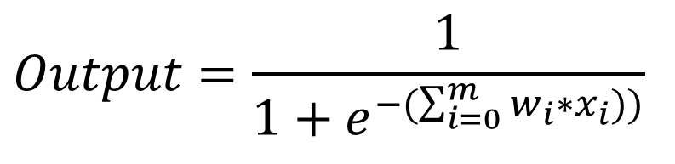
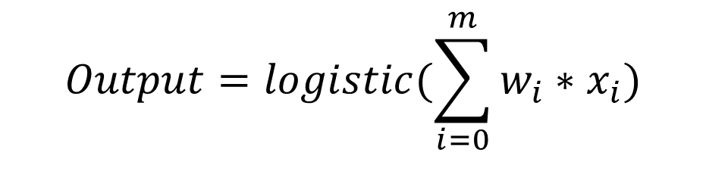
Assume Each Neuron with Logistic Activation Function
$$Output=logistic(\sum_{i=0}^{m}{w_{i}∗x_{i})}$$
Output
w₀
w₄
w₁
w₂
w₃
$$Output=\frac{1}{1+e^{−(\sum_{i=0}^{m}{w_{i}∗x_{i})})}}$$
x₀
x₁
x₂
x₃
x₄
Inputs
The term w₀ corresponds to
bias (threshold) and x₀=1.
This is true throughout the network for all hidden and output nodes.
output
hidden
input

Slide 9
Error Minimization
The goal is to learn weights to minimize the following squared error (or loss):
where D is the set of training examples, K is the set of output units, t_{kd} and o_{kd} are, respectively, the teacher (correct) and model output for unit k for example d
Inner summation: For each output
Outer summation: For each training example

Slide 10
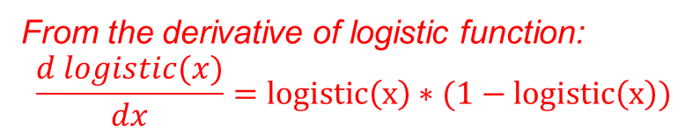
Backpropagation
Backpropagation is an iterative algorithm for learning the weights of a neural network to minimize its error
Differentials of the error function are used in deriving the weight changing rules
Each weight w_{ij} (connecting node o_{i} to o_{j}) is changed by:
where η is the learning rate
t_{j} is the correct teacher output for unit j
δ_{j} is the error measure for unit j (as defined above)
From the derivative of logistic function:
$$\frac{d logistic(x)}{dx}=logistic\left(x\right)∗(1−logistic\left(x\right))$$
Actual error at output
“Propagated” error

Slide 11
Error Backpropagation Example
Consider an output unit o_{j} connected to hidden unit o_{i} with an edge of weight w_{ji}
o_{j}
output
w_{ji}
o_{i}
hidden
input

Slide 12
Error Backpropagation Example
First calculate error of output units and use this to change the top layer of weights.
Suppose current output: o_{j}=0.2
Suppose crorect output: t_{j}=1.0
Error δ_{j} = o_{j}(1–o_{j})(t_{j}–o_{j})
= 0.2(1–0.2)(1–0.2)=0.128
o_{j}
output
w_{ji}
Update weights into j
o_{i}
hidden
input

Slide 13
Error Backpropagation Example
First calculate error of output units and use this to change the top layer of weights.
Suppose current output: o_{j}=0.2
Suppose crorect output: t_{j}=1.0
Error δ_{j} = o_{j}(1–o_{j})(t_{j}–o_{j})
= 0.2(1–0.2)(1–0.2)=0.128
o_{j}
output
w_{ji}
Update weights into j
o_{i}
hidden
input

Slide 14
Error Backpropagation Example
First calculate error of output units and use this to change the top layer of weights.
Suppose current output: o_{j}=0.2
Suppose crorect output: t_{j}=1.0
Error δ_{j} = o_{j}(1–o_{j})(t_{j}–o_{j})
= 0.2(1–0.2)(1–0.2)=0.128
o_{j}
output
w_{ji}
Update weights into j
o_{i}
hidden
input

Slide 15
Error Backpropagation Example
First calculate error of output units and use this to change the top layer of weights.
Suppose current output: o_{j}=0.4
Suppose crorect output: t_{j}= 0
Error δ_{j} = o_{j}(1–o_{j})(t_{j}–o_{j})
= 0.4(1–0.4)(0–0.2) = -0.192
o_{j}
w_{ji}
output
Update weights into j
o_{i}
hidden
input

Slide 16
Error Backpropagation Example
First calculate error of output units and use this to change the top layer of weights.
Suppose current output: o_{j}=0.4
Suppose crorect output: t_{j}= 0
Error δ_{j} = o_{j}(1–o_{j})(t_{j}–o_{j})
= 0.4(1–0.4)(0–0.2) = -0.192
o_{j}
output
Update weights into j
w_{ji}
o_{i}
hidden
input

Slide 17
Error Backpropagation Example
First calculate error of output units and use this to change the top layer of weights.
Suppose current output: o_{j}=0.4
Suppose crorect output: t_{j}= 0
Error δ_{j} = o_{j}(1–o_{j})(t_{j}–o_{j})
= 0.4(1–0.4)(0–0.2) = -0.192
o_{j}
output
w_{ji}
Update weights into j
o_{i}
hidden
input

Slide 18
Error Backpropagation
Next calculate error for hidden units based on errors on the output units it feeds into.
output
w_{1j}
w_{2j}
o_{j}
hidden
w_{ji}
o_{i}
input

Slide 19
Error Backpropagation
Finally update bottom layer of weights based on errors calculated for hidden units.
output
Update weights into j
o_{j}
hidden
w_{ji}
o_{i}
input

Slide 20
Error Backpropagation
Finally update bottom layer of weights based on errors calculated for hidden units.
output
Update weights into j
o_{j}
hidden
w_{ji}
o_{i}
input

Slide 21
Error Backpropagation
Finally update bottom layer of weights based on errors calculated for hidden units.
output
Update weights into j
o_{j}
hidden
w_{ji}
o_{i}
input

Slide 22
Error Backpropagation
Finally update bottom layer of weights based on errors calculated for hidden units.
output
Update weights into j
o_{j}
hidden
w_{ji}
input
o_{i}

Slide 23
Error Backpropagation
Finally update bottom layer of weights based on errors calculated for hidden units.
output
Update weights into j
o_{j}
hidden
w_{ji}
input
o_{i}

Slide 24
Error Backpropagation
Finally update bottom layer of weights based on errors calculated for hidden units.
output
Update weights into j
o_{j}
hidden
input
Similarly update other weights from input nodes to hidden nodes.

Slide 25
Error Backpropagation
Finally update bottom layer of weights based on errors calculated for hidden units.
output
Update weights into j
o_{j}
hidden
input
Similarly update other weights from input nodes to hidden nodes.

Slide 26
Backpropagation Training Algorithm
Create the L-layer network with full connectivity
between layers. Set weights to small random real values.
Until all training examples produce the correct value (within ε), or
mean squared error ceases to decrease, or other termination criteria:
Begin epoch
For each training example, d, do:
Calculate network output for d’s input values
Compute error between current output and correct output for d
Update weights by backpropagation update rules
End epoch
Forward
pass
Backward
pass

Slide 27
Comments on Training Algorithm
Unlike perceptron training, backpropagation training comes with no guarantees – it is not guaranteed to converge to zero training error; may converge to local optima or oscillate indefinitely
However, in practice, it does converge to low error for many large networks on real data
Many epochs (thousands) may be required, hours or days of training for large networks is not uncommon

Slide 28
Over-Training Prevention
Running too many epochs can result in over-fitting
Keep a hold-out validation set and test accuracy on it after every epoch. Stop training when additional epochs actually increase validation error.
error
on test data
on training data
0
# training epochs

Slide 29
Adapting Neural Networks for Classification
Neural network’s outputs are numbers, how to we do classification (e.g. three classes: red/green/blue)?
We can leverage the fact that a neural network can have multiple outputs
We can make one output specific to each class
If a task had three classes: Red, Blue and Green
Red
score
Blue
score
Green
score
output
hidden
input

Slide 30
Adapting Neural Networks for Classification
What should be the correct outputs the networks should be trained on?
One-hot encoding
If correct output is Blue for a training example:
0
1
0
output
hidden
input

Slide 31
Adapting Neural Networks for Classification
How should the predicted output scores of the neural networks be interpreted/used?
Highest score => predicted class?
We can do even better: Force the outputs to be probabilities that add to 1
Red
Score=0.8
Blue
Score =0.7
Green
Score = 0.9
output
hidden
input

Slide 32
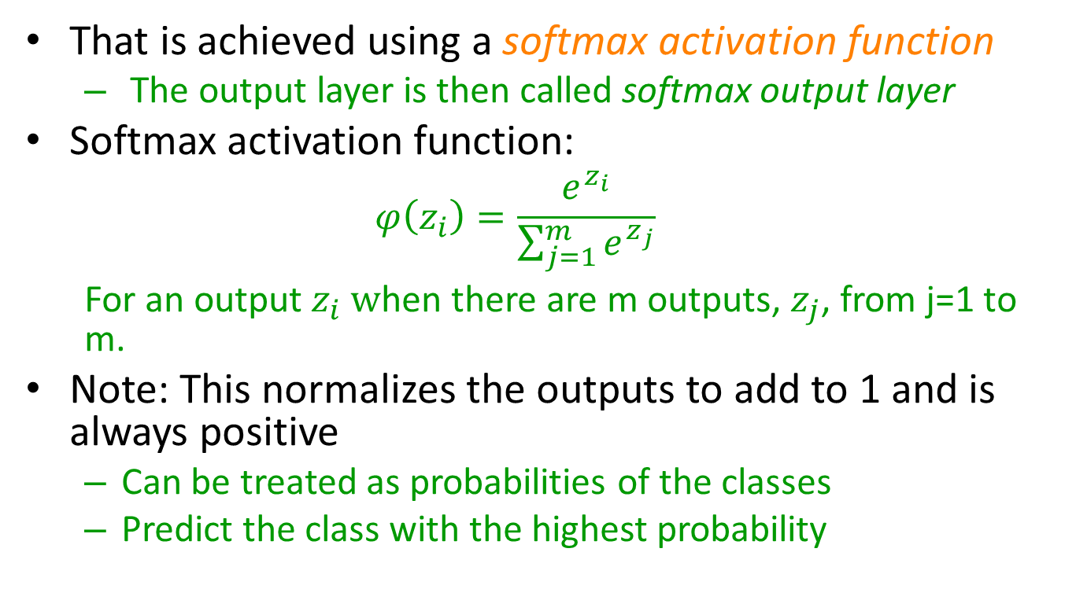
Adapting Neural Networks for Classification
That is achieved using a softmax activation function
The output layer is then called softmax output layer
Softmax activation function:
$$φ\left(z_{i}\right)=\frac{e^{z_{i}}}{\sum_{j=1}^{m}{e^{z_{j}}}}$$
For an output $z_{i} w$hen there are m outputs, $z_{j}$, from j=1 to m.
Note: This normalizes the outputs to add to 1 and is always positive
Can be treated as probabilities of the classes
Predict the class with the highest probability

Slide 33
Adapting Neural Networks for Classification
Softmax output layer:
Red
probability=
$$φ\left(z_{red}\right)$$
Blue
probability=
$$φ\left(z_{blue}\right)$$
Green
probability=
$$φ\left(z_{green}\right)$$
output
hidden
input

Slide 34
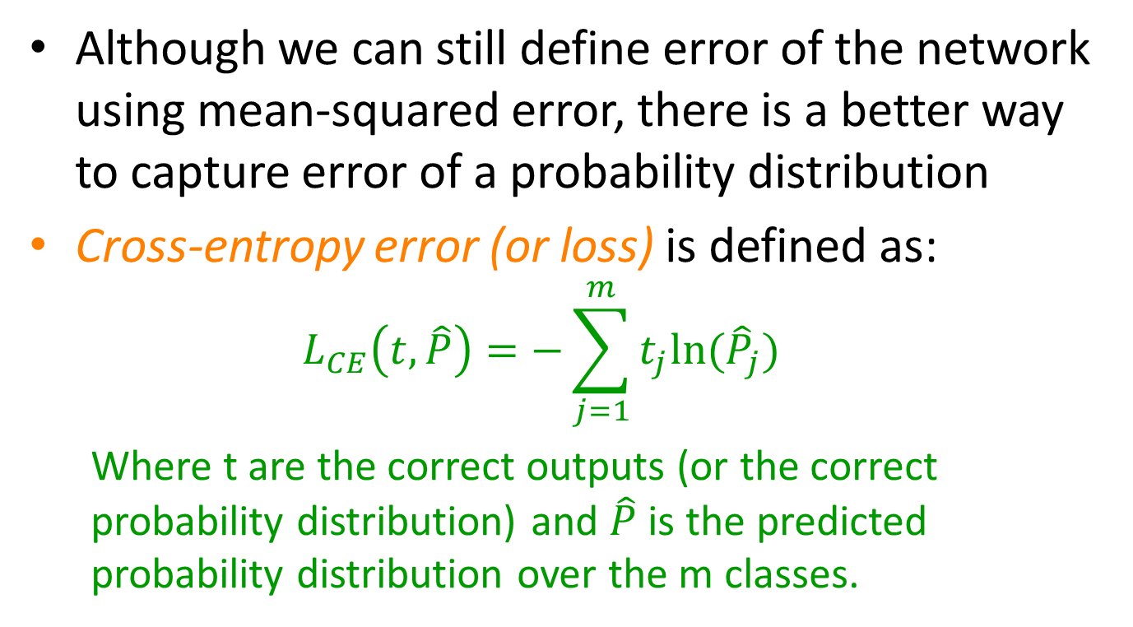
Adapting Neural Networks for Classification
Although we can still define error of the network using mean-squared error, there is a better way to capture error of a probability distribution
Cross-entropy error (or loss) is defined as:
$$L_{CE}\left(t,\hat{P}\right)=−\sum_{j=1}^{m}{t_{j}ln⁡({\hat{P}}_{j})}$$
Where t are the correct outputs (or the correct probability distribution) and $\hat{P}$ is the predicted probability distribution over the m classes.

Slide 35
Adapting Neural Networks for Classification
Correct outputs
$$t_{0}$$
$$t_{1}$$
$$t_{2}$$
Predicted outputs
$${\hat{P}}_{0}$$
$${\hat{P}}_{1}$$
$${\hat{P}}_{2}$$
output
hidden
input
$L_{CE}\left(t,\hat{P}\right)=−{(t}_{0}\ln\left({\hat{P}}_{0}\right)+$ $t_{1}\ln\left({\hat{P}}_{1}\right)+t_{2}\ln\left({\hat{P}}_{2}\right))$

Slide 36
Adapting Neural Networks for Classification
Correct outputs
0
1
0
Predicted outputs
Predicted outputs
$${\hat{P}}_{0}$$
$${\hat{P}}_{1}$$
$${\hat{P}}_{2}$$
output
hidden
input
$L_{CE}\left(t,\hat{P}\right)=−{(t}_{0}\ln\left({\hat{P}}_{0}\right)+$ $t_{1}\ln\left({\hat{P}}_{1}\right)+t_{2}\ln\left({\hat{P}}_{2}\right))$
$L_{CE}\left(t,\hat{P}\right)=−$ $\ln\left({\hat{P}}_{1}\right)$

Slide 37
Adapting Neural Networks for Classification
If the correct outputs are in one-hot encoding, cross-entropy error simplifies to:
$$L_{CE}\left(t,\hat{P}\right)=−ln⁡({\hat{P}}_{∗})$$
where ${\hat{P}}_{∗}$ is the predicted probability of the true class.
Intuitively:
If the predicted probability for the true class is high, close to 1, error will be very low (because ln(1)=0)
Because they add to 1, other classes get very low probabilities
If the predicted probability for the true class is low, then the error will be high (because -ln(close to 0) is very high)
Because they add to 1, some other class(es) get high probability

Slide 38
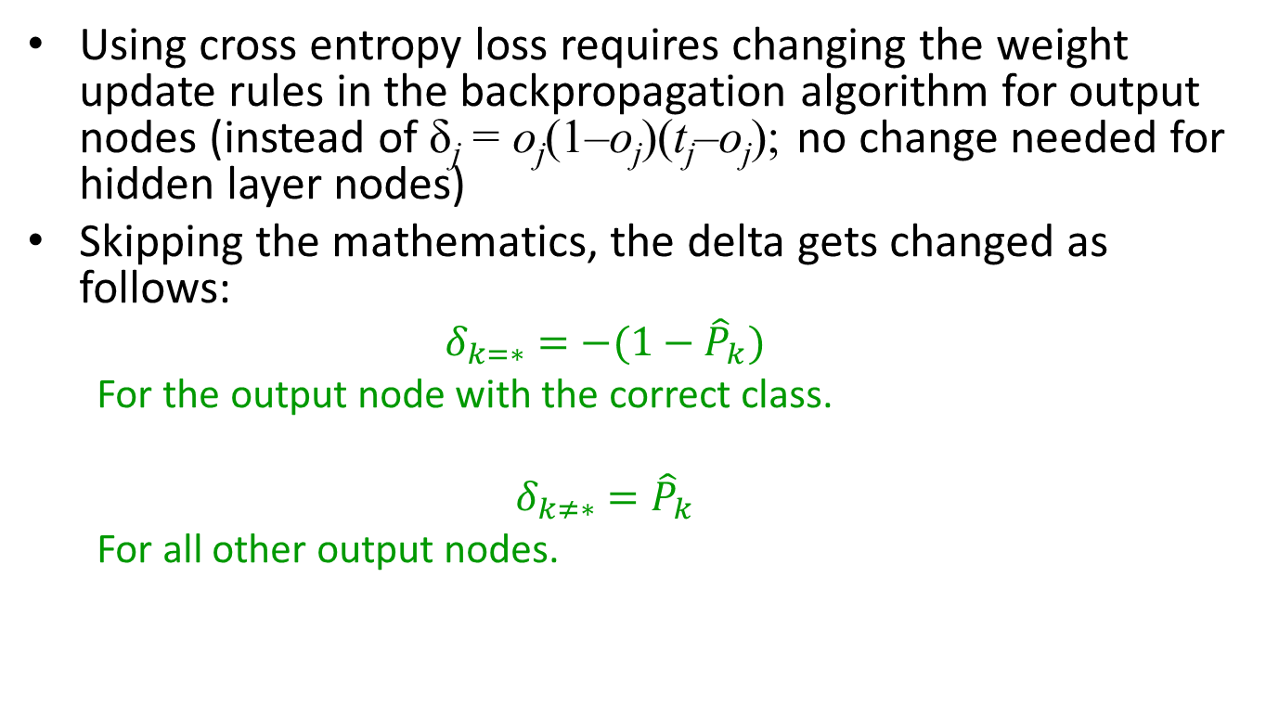
Adapting Neural Networks for Classification
Using cross entropy loss requires changing the weight update rules in the backpropagation algorithm for output nodes (instead of δ_{j} = o_{j}(1–o_{j})(t_{j}–o_{j}); no change needed for hidden layer nodes)
Skipping the mathematics, the delta gets changed as follows:
$$δ_{k=∗}=−(1−{\hat{P}}_{k})$$
For the output node with the correct class.
$$δ_{k≠∗}={\hat{P}}_{k}$$
For all other output nodes.

Slide 39
Adapting Neural Networks for Classification
Summary of adapting neural networks for classification:
Represent target using one-hot encoding
This will lead to as many outputs as the number of classes
Use softmax activation for the output layer
Use cross-entropy loss for training the neural network

Slide 40
Neural Network Comments
Advantages
High tolerance for noisy or incomplete data; graceful degradation
Could be applied when there is little knowledge about relationships between inputs (no independence assumptions etc. needed)
=> Many successful applications
Disadvantages
Does not come with theoretical guarantees
Generally takes a long training time compared to other machine learning techniques
Testing is fast though
Although some methods exist to derive human-interpretable rules from a learned neural network, neural networks are largely “opaque” or like a “blackbox” and do not tell how and why they are making the decision

